Slide 1

Application Layer (HTTP)
Lecture 2 | CSE421 – Computer Networks
Department of Computer Science and Engineering
School of Data & Science

Slide 2
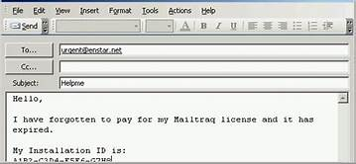
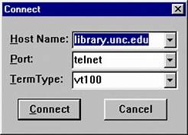



Applications
1970-1980
1990-2000
2000-2020
2020 -

Slide 3

Objectives
Principles of network applications
Web and HTTP
Electronic Mail (SMTP, POP3, IMAP)
DNS
P2P Applications
Video streaming and content distribution networks

Slide 4
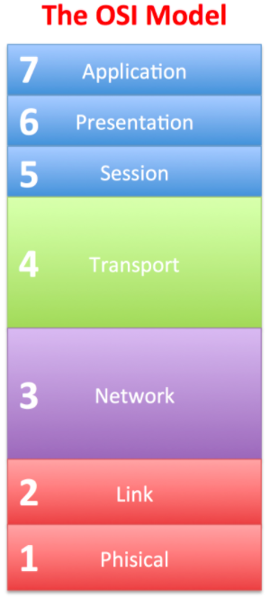
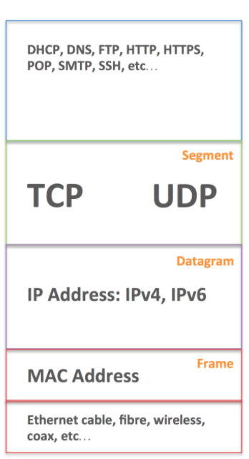
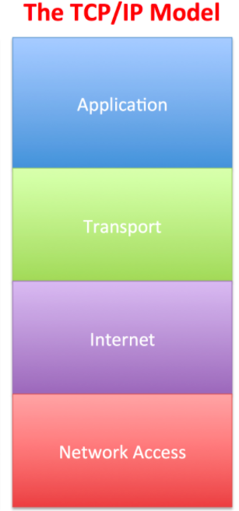
Network Models
Data
Port Numbers
Data Link
Physical

Slide 5


Application Layer
Application Layer Protocols
  Provide the rules and formats that govern how data is treated in the application layer.
Application Software
  The programs used to communicate over the network.
For example:
  When displaying a web page:
    The Application Layer uses the HTTP(Hyper Text Transfer Protocol) Protocol.
    The Application Software is your Web browser.

Slide 6
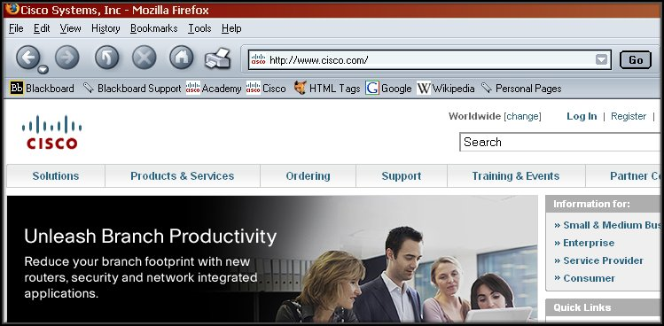
Application Layer

Slide 7
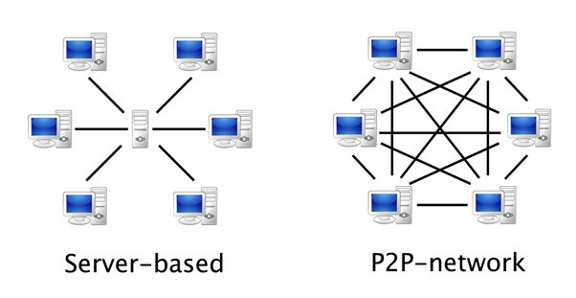
Application Layer
When accessing information on a device, the data may not be
physically stored on that device.
If that is the case, a request must be made to the device where the data resides.
Two methods:
  Client/Server
  Peer-to-Peer (P2P)
  Client-Server
  Peer-to-Peer(P2P)

Slide 8
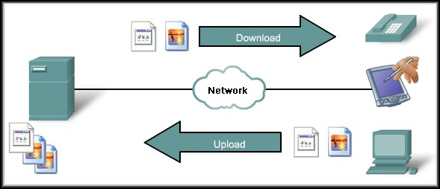
Client/Server Model
May also require control information.
User Authentication
or identify a file to be transferred.
Clients – hardware, software combination
The client begins the exchange by making a request for data.
The server responds with one or more streams of data.
Resources are stored on the server.

Slide 9
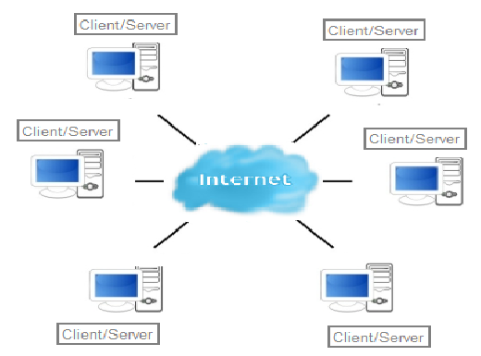
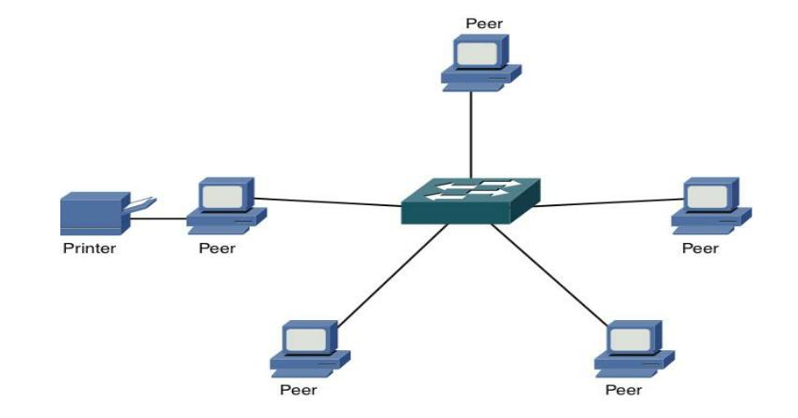
Peer-to-Peer Model
Two or more computers are connected via a network and can share resources (such as printers and files) without having a dedicated server.
End devices (peers) can function as either a server or client depending upon the required service.
Face challenges of security, performance, and reliability due to their highly decentralized structure
Notes:
Every connected end device (known as a peer) can function as either a server or a client.
Peer-to-peer networks decentralize the resources on a network without using a centralized server.
One computer might assume the role of server for one transaction while simultaneously serving as a client for another. The roles of client and server are set on a per request basis.

Slide 10
Web and HTTP
Part 2

Slide 11
Objectives -Part 2
WWW – The Web
HTTP
HTTP Messages and Methods

Slide 12
WWW—The Web
Web, short for the World Wide Web (WWW)
A system of interconnected documents and resources that are accessed over the Internet using a web browser.
Component | Description
Web Page | A single document (like a page in a book), written in HTML
Website | A collection of related web pages under a domain (e.g., nytimes.com)
URL | The address of a web page (e.g., https://www.example.com/page.html)
Web Browser | Software like Chrome, Firefox, Safari used to view web pages
Web Server | A computer that stores and sends web pages to users
HTTP/HTTPS | Protocols used to request and transfer web pages

Slide 13
Relation between Web and HTTP
  Web: Library of books
  HTTP: Librarian
    Finds the book (web page)
    Brings it to you
    Handles your requests (like turning pages, searching, etc.

Slide 14

WWW- The Web
A web page or webpage is a document that is viewed in an Internet browser.
It may contain text, graphics, and hyperlinks to other web pages and files.
A web page consists of objects
Web page consists of base HTML-file which includes several referenced objects
Objects can be HTML file, JPEG image, Java applet, audio file…

Slide 15
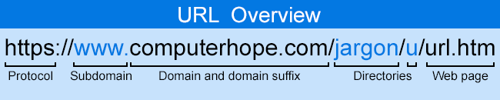
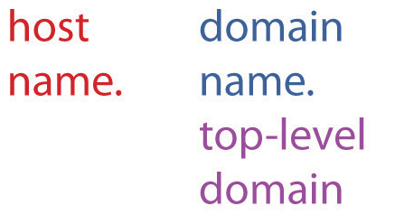
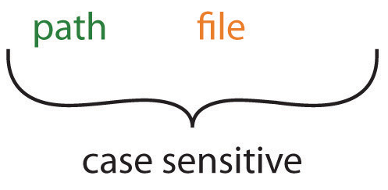
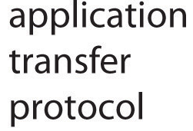
WWW—The Web
A web page can be accessed by entering a URL address into a web browser's address bar.

Slide 16
HTTP
  Defines the format and sequence of messages exchanged between browser and Web server.
  Defines how Web clients request Web pages from Web servers and how servers transfer Web pages to clients.
  Use Socket to access networks
  Use Transport layer protocol (TCP) for transferring data

Slide 17

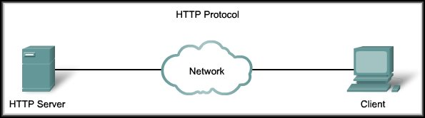
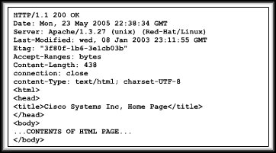

HTTP
HTTP Protocol
HTTP request
Web Server
HTTP response
Web Browser
Web browsers are the client applications used to interpret the HTTP application protocol received from a web server.

Slide 18
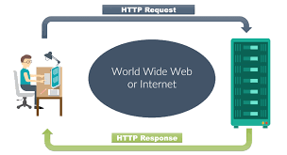
HTTP messages
Two types of HTTP messages:
HTTP Request message
HTTP Response message

Slide 19
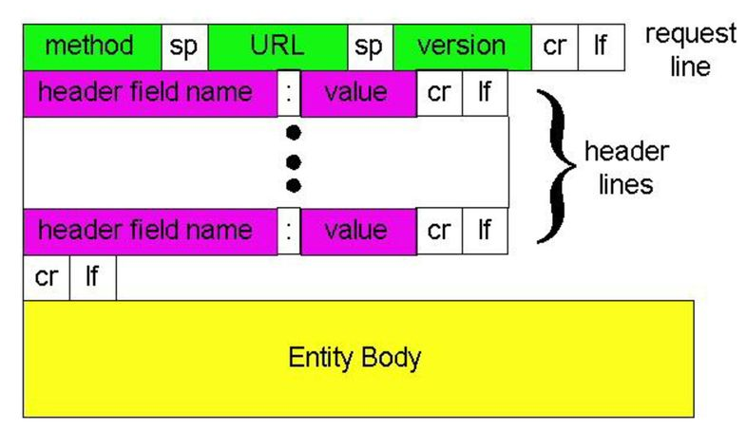
HTTP request message format
HTTP request message:
  ASCII (human-readable format)
carriage return character
line-feed character

Slide 20
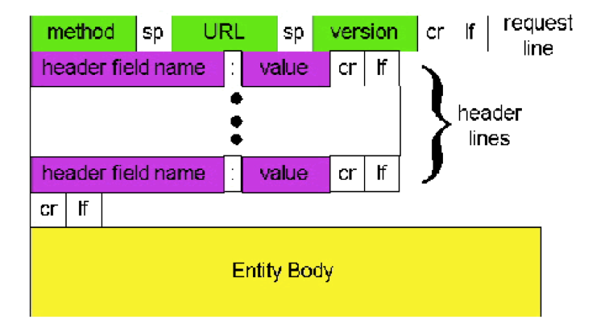
HTTP request message: Example
request line
(GET, POST,
HEAD,PUT,DELETE
commands)
GET //somedir/index.html HTTP/1.1\r\n
Host: www.someschool.edu\r\n
User-Agent: Firefox/3.6.10\r\n
Accept: text/html,image/gif, image jpeg\r\n
Accept-Language: fr \r\n
Connection: close\r\n
\r\n
header
lines
carriage return,
line feed at start
of line indicates
end of header lines

Slide 21
HTTP Method types
HTTP/1.1:
GET, POST, HEAD
PUT/PATCH
  Update data
  Replaces existing objects
DELETE
  Deletes data
HTTP/1.0:
GET
  Primarily gets information only
  Retrieve data
POST
  Creating new data
HEAD
  Also retrieve but asks server to leave requested object out of response

Slide 22
GET
HEAD
-- REQUEST --
GET /index.html HTTP/1.1
Host: www.example.com
-- RESPONSE --
HTTP/1.1 200 OK
Content-Type: text/html
Content-Length: 1240
Cache-Control: max-age=3600
<!DOCTYPE html>
<html>
<head>...</head>
<body>Welcome to the site!</body>
</html>
-- REQUEST --
HEAD /index.html HTTP/1.1
Host: www.example.com
-- RESPONSE --
HTTP/1.1 200 OK
Content-Type: text/html
Content-Length: 1240
Cache-Control: max-age=3600

Slide 23
Uploading form input
POST method:
Web page often includes form input
Input is uploaded to server in entity body
URL method:
Uses GET method
Input is uploaded in URL field of request line:
www.somesite.com/animalsearch?monkeys&banana
https://www.google.com/search?q=cse421&num=10&sca_esv=.........

Slide 24
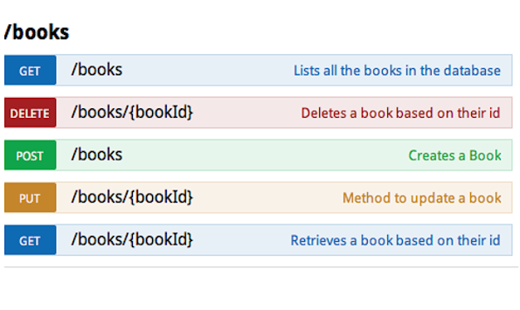
HTTP Methods
Source :https://javarevisited.blogspot.com/2016/04/what-is-purpose-of-http-request-types-in-RESTful-web-service.html

Slide 25
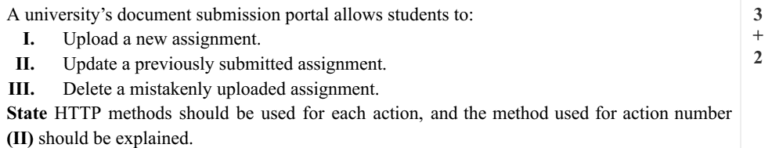
I. POST
II. PUT
III. DELETE

Slide 26
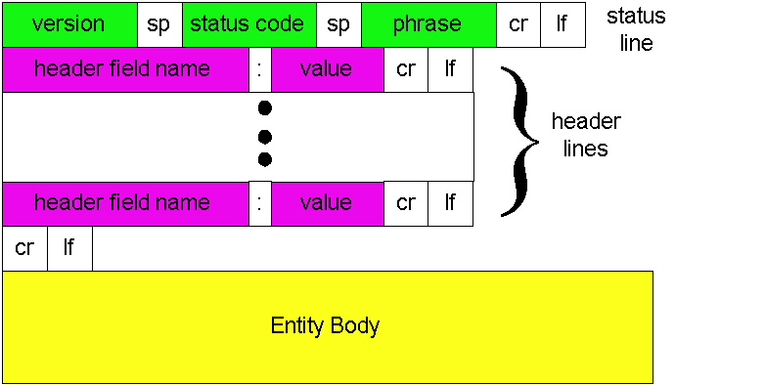
HTTP response message: General Format

Slide 27
HTTP response message : Example
Status line
(protocol
status code
status phrase)
HTTP/1.1 200 OK\r\n
Date: Sun, 26 Sep 2010 20:09:20 GMT\r\n
Server: Apache/2.0.52 (CentOS)\r\n
Last-Modified: Tue, 30 Oct 2007 17:00:02 GMT\r\n
ETag: "17dc6-a5c-bf716880"\r\n
Accept-Ranges: bytes\r\n
Content-Length: 2652\r\n
Keep-Alive: timeout=10, max=100\r\n
Connection: close\r\n
Content-Type: text/html; charset=ISO-8859-1\r\n
\r\n
data data data data data ...
Header
lines
data, e.g.,
requested
HTML file

Slide 28
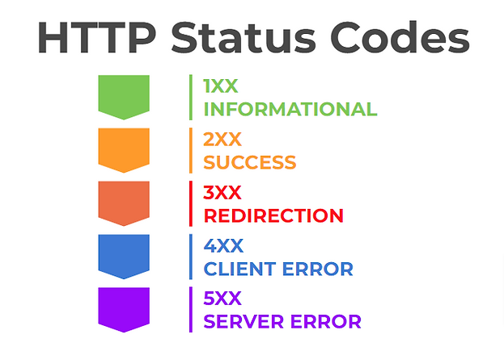
HTTP response status codes
Status code appears in 1st line in server-to-client response message.
HTTP Status codes:

Slide 29
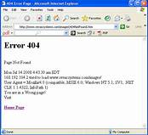
HTTP response status codes
Some sample codes:
100 Continue
  everything ok so far, client should continue with the request
200 OK
  request succeeded, requested object later in this message
301 Moved Permanently
  requested object moved, new location specified later in this message (Location:)
400 Bad Request
  request message not understood by server
404 Not Found
  requested document not found on this server
505 HTTP Version Not Supported

Slide 30
Objectives -Part 3
HTTP Connections
  Non Persistent
  Persistent

Slide 31

HTTP Connections
Suppose user enters URL:
(contains text, references to 10
jpeg images)
www.someSchool.edu/someDepartment/home.index
1a. HTTP client initiates TCP connection to HTTP server at www.someSchool.edu
1b. HTTP server www.someSchool.edu accepts TCP connection, notifying client
2. HTTP client sends HTTP request message (containing URL) into TCP connection socket. Message indicates that client wants object someDepartment/home.index
3. HTTP server receives request message, forms response message containing requested object, and sends message into its socket
time

Slide 32
HTTP Connections (cont.)
5. HTTP server closes TCP connection.
4. HTTP client receives response message containing html file, displays html. Parsing html file, finds 10 referenced jpeg objects
6. Steps 1-5 repeated for each of 10 jpeg objects
time
Non-persistent HTTP

Slide 33
Non-persistent HTTP: response time
Note : One Object
RTT (Round Trip Time): time for a small packet to travel from client to server and back
HTTP response time:
One RTT to initiate TCP connection
One RTT for HTTP GET request and the HTTP response to return
Non-persistent HTTP total response time =
  2*RTT+ file transmission time
Initiate TCP
connection
RTT
Request
file
RTT
Time to
transmit
file
File
received
Initiate TCP
termination
time
time

Slide 34
Non-persistent HTTP: response time for two objects
Total Response Time for two objects
RTT :
  2* RTT per object
  For 2 objects RTT is : 2*2*RTT
File Transmission time
  For both objects
TCP
connection
RTT
Request
For obj 1
Obj 1
received
TCP
termination
TCP
connection
Request
For obj 2
Obj 2
received
TCP
termination
time
time

Slide 35
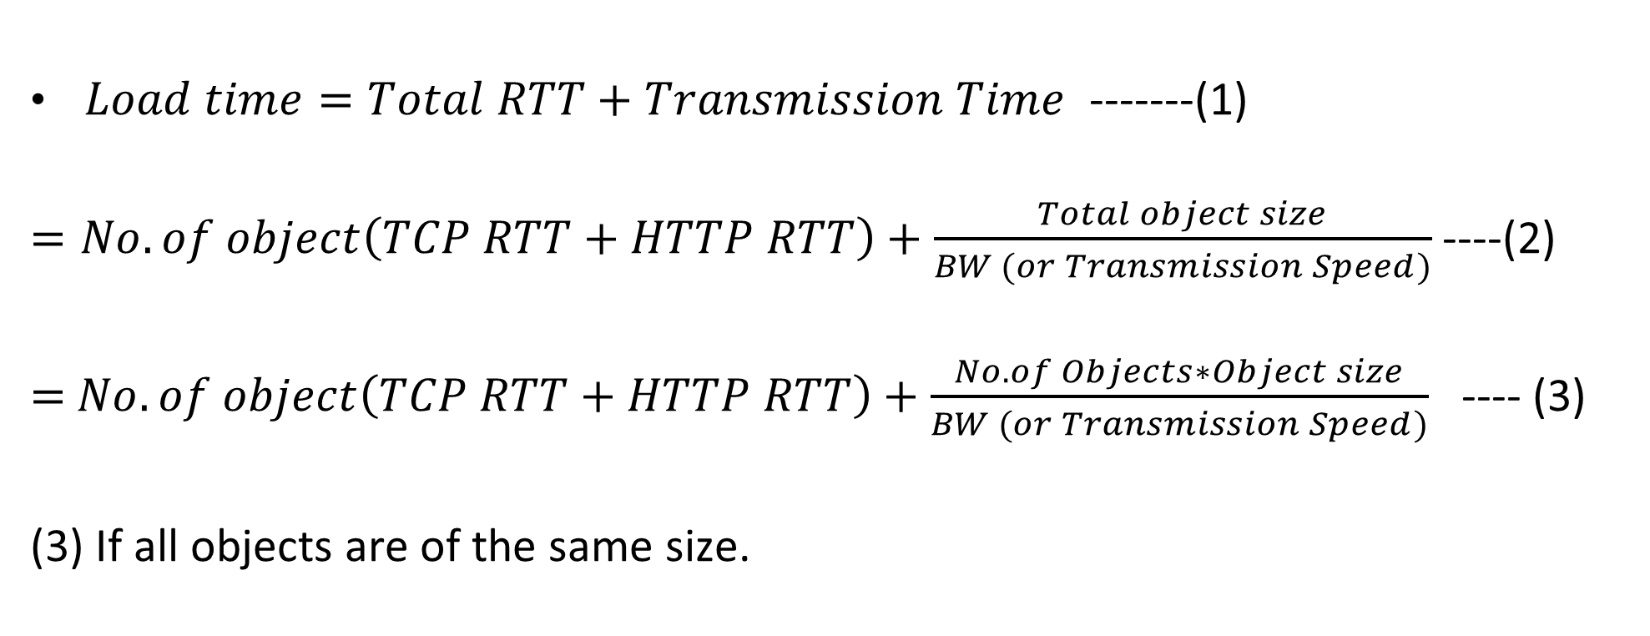
$Load time=Total RTT+Transmission Time$ -------(1)
$=No. of object\left(TCP RTT+HTTP RTT\right)+\frac{Total object size}{BW (or Transmission Speed)}$ ----(2)
$=$ $No. of object\left(TCP RTT+HTTP RTT\right)+\frac{No. of Objects∗Object size}{BW (or Transmission Speed)}$ ---- (3)
(3) If all objects are of the same size.

Slide 36
HTTP Transmission Calculation
You wish to access the web page "www.games.com", so you write the URL in your web browser.
The Web page associated with the link contains exactly 10 object/s in total. Each object size is 10 MB.
Let 25 ms denote the time required to send a TCP request from PC to server.
Assuming 100 Mbps the transmission speed of the web server
Non-persistent HTTP is being used.
Please calculate the total time in ms that will take the web browser to load your page.

Slide 37
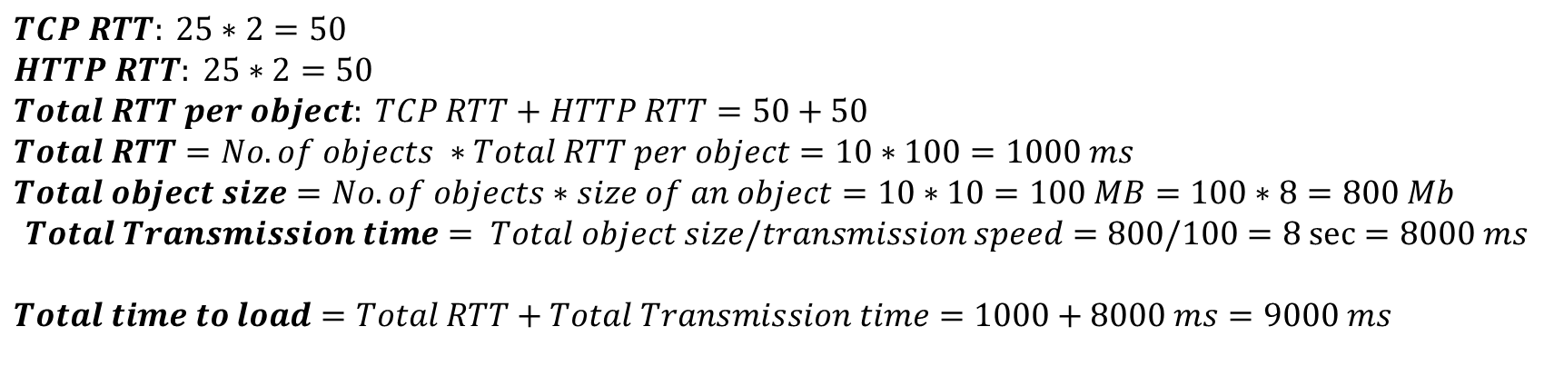

Slide 38
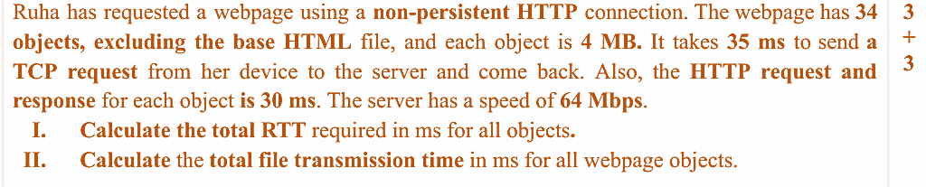
Total RTT=(TCP RTT+HTTP RTT)* No. of Objects=(35+30)*35=2275
Total transmission time=Total size/server speed
= No. of objects*size of each object/Server speed
=35*4*8/64=17.5 sec=17500 ms
Load time=Total RTT+Total transmission time=2275+17500=19775 ms

Slide 39
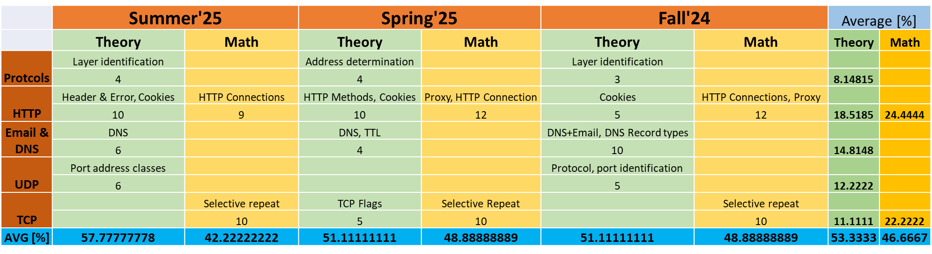
Analysis of Previous Semesters' Questions
Full Marks: 45

Slide 40
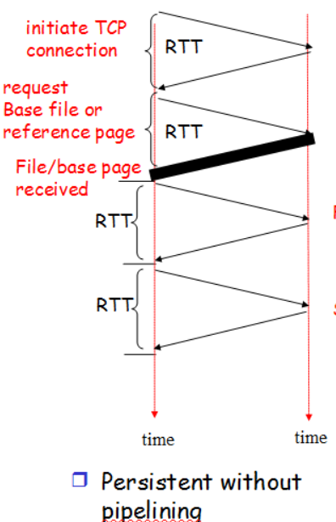
Persistent HTTP
Persistent HTTP:
Server leaves connection open after sending response
Subsequent HTTP messages between same client/server sent over open connection
Client sends requests as soon as it encounters a referenced object
As little as one RTT for each of the referenced objects
2nd object
3rd object

Slide 41
Non-persistent HTTP vs Persistent HTTP
TCP
connection
TCP
connection
RTT
RTT
Request
For obj 1
Request
For obj 1
Obj 1
received
Obj 1
received
TCP
termination
Request
For obj 2
Obj 2
received
TCP
connection
Request
For obj 2
TCP
termination
Obj 2
received
TCP
termination
time
time
time
time

Slide 42
Persistent without pipeline
After TCP setup, one request for each object.
Persistent with pipeline
After TCP connection, send all requests back-to-back.
Receive responses one after another, in order

Slide 43
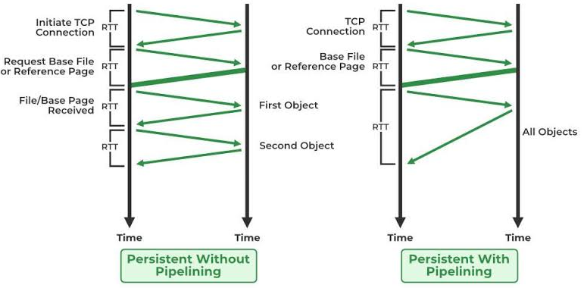
HTTP Persistent Connections
Client:
GET object1
GET object2
GET object3
Server:
[responds with object1]
[responds with object2]
[responds with object3]
Client: GET object1
Server: [responds with object1]
Client: GET object2
Server: [responds with object2]
... and so on

Slide 44
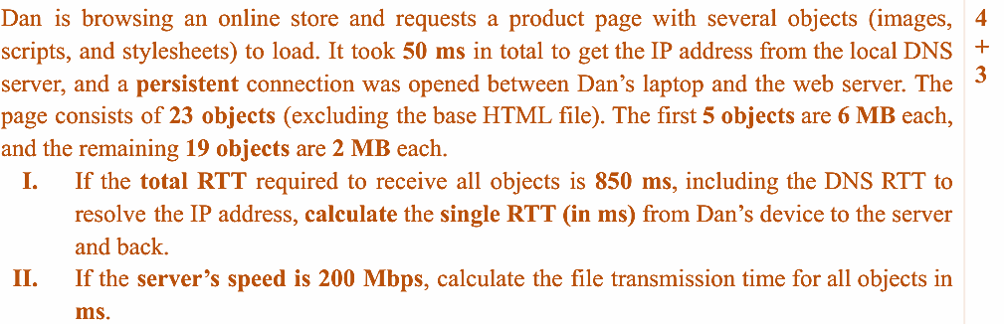
No. of RTTs= 1 TCP RTT+24 HTTP RTT=25 RTT
Total RTT=850-50=800
25*RTT=800
RTT=32 ms
Load time =Total RTT+ Total transmission time
Load time=850+2720
Load time=3570 ms
Total size=(5*6+19*2)*8=544 Mb
Total transmission time= Total size/Server speed
=544/200=2.72 sec=2720 ms

Slide 45
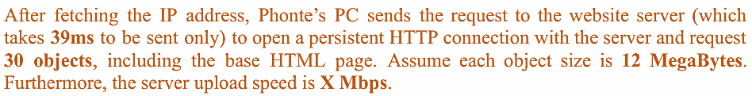
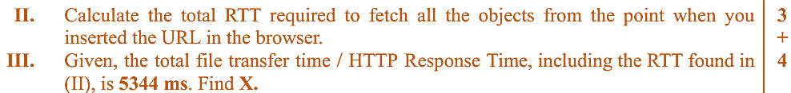
RTT=39*2=78 ms
No. of RTT=No. of objects+1 RTT for TCP=30+1=31
Total RTT=31*78=2418 ms
Total RTT + total object Object transmission time=Total file transmission time (or load time)
2418+Total object transmission time=5344
Total object transmission time=5344-2418=2926 ms=2.926 s
We know, Total object transmission time=total size/server speed
Server speed=Total size/Total object transmission time=12*8*30/2.926=0.9842=984.2 Mbps

Slide 46

COOKIES
Part 4

Slide 47
Objectives -Part 4
Stateless HTTP
Cookies
Example of how cookies operate
Issues related to cookies

Slide 48
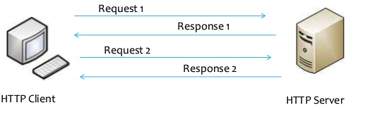
Stateless HTTP
Do not remember previous request response chain.
Protocols that maintain “state” are complex!
Past history (state) must be maintained
If server/client crashes, their views of “state” may be inconsistent, must be reconciled
HTTP is “stateless”
Server maintains no information about past client requests

Slide 49
User-server state: cookies
Many Websites use cookies
Four components:
  1) Cookie header line of HTTP response message (cookie-id)
  2) Cookie header line in next HTTP request message (mention the cookie-id)
  3) Cookie file kept on user’s host, managed by user’s browser
  4) Back-end database at Web site
Example:
Susan always access Internet from PC
Visits specific e-commerce site for first time
When initial HTTP requests arrives at site, site creates:
  Unique ID
  Entry in backend database for ID

Slide 50



Cookies: keeping “state” (cont.)
ebay 8734
Usual HTTP Request
Server creates ID for user 1678
Entry in backend database
Usual HTTP Response
Set-cookie 1678
Amazon 1678
ebay 8734
Usual HTTP Request
Cookie : 1678
Access
Amazon Server
Cookie specific action
Usual HTTP Response
Cookie : 1678
time
time

Slide 51
Cookies: keeping “state” (cont.)
One week later
Usual HTTP Request
Cookie : 1678
Amazon 1678
ebay 8734
Cookie specific action
Access
Usual HTTP Response
Cookie 1678
Amazon Server
Amazon 1678
ebay 8734
time
time

Slide 52
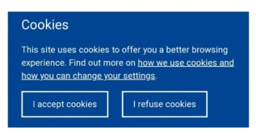
Cookies (continued)
aside
What cookies can be used for:
Authorization
Shopping carts
Recommendations
User session state (Web email)
Cookies and privacy:
Cookies permit sites to learn a lot about you
You may supply name and email to sites
How to keep “state”:
Protocol endpoints: maintain state at sender/receiver over multiple transactions
Cookies: http messages carry state

Slide 53
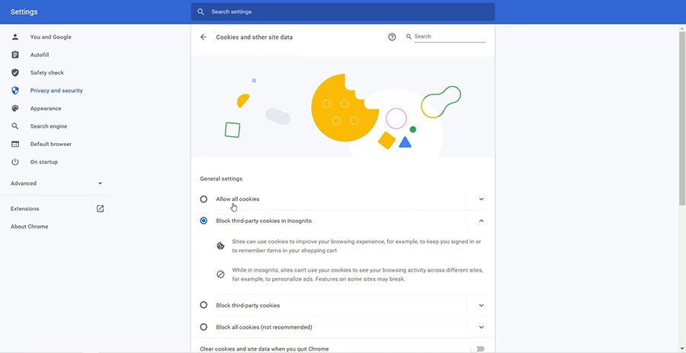

Slide 54
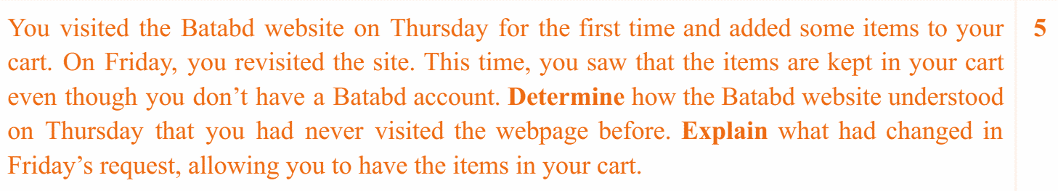
Answer 1: HTTP request did not have any Cookie ID
Thursday: the website stored cookie ID in the browser
Answer 2: Friday: client send HTTP request with the Cookie ID
Server retrieve the user info (cart info) from its database using the ID

Slide 55
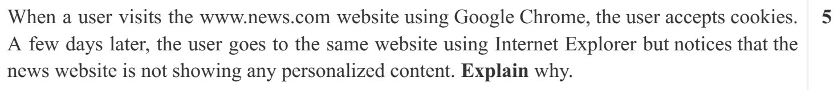
Cookie was stored on in Chrome.
Internet Explorer does not have any cookie ID.
HTTP request does not have any cookie
Server cannot recognize the user

Slide 56
Web Cache or Proxy Server
Part 5

Slide 57
Objectives - Part 5
What is a Web Cache (Proxy Servers)?
Advantages of Web Cache
Web Caching Example
Problems of Web Caching
Conditional-GET

Slide 58

Web caches (proxy server)
Goal: Satisfy client request without involving origin server
User sets browser: Web accesses via cache
Browser sends all HTTP requests to cache
  Object in cache: cache returns object
  Else cache requests object from origin server, then returns object to client
proxy
server
HTTP request
HTTP request
client
origin
server
HTTP response
HTTP response
HTTP request
HTTP response
client

Slide 59
More about Web caching
A Proxy Server acts as both client and server
  Server for original requesting client
  Client to origin server
Typically Proxy Servers are installed by ISPs
  University
  Company
  Residential ISP

Slide 60
Advantages of Web Caching
Reduce response time for client request
Saves bandwidth (prevents downloading of same content multiple times)
Helps log usage, block unwanted traffic
Internet dense with caches:
  enables “poor” content providers to effectively deliver content (so too does P2P file sharing)

Slide 61
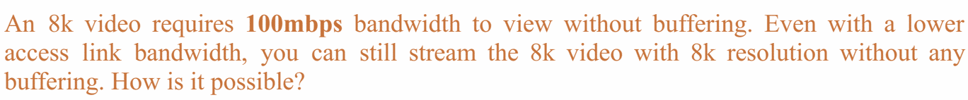
Content Delivery Networks (CDNs)
The video may be served from servers close to your location (proxy)

Slide 62


Caching example:
Assumptions:
Avg object size: 1 Mbits
Avg request rate from browsers to origin servers: 15/sec
Institutional Bandwidth: 100 Mbps
RTT from institutional router to any origin server: 2 sec
Access link rate: 15 Mbps
origin
servers
Public
Internet
HTTP request
15 Mbps
access link
HTTP request
HTTP request
Institutional
network
100 Mbps LAN

Slide 63
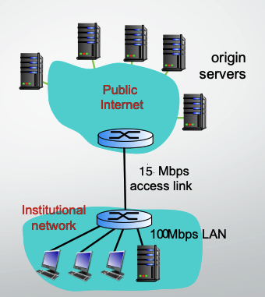
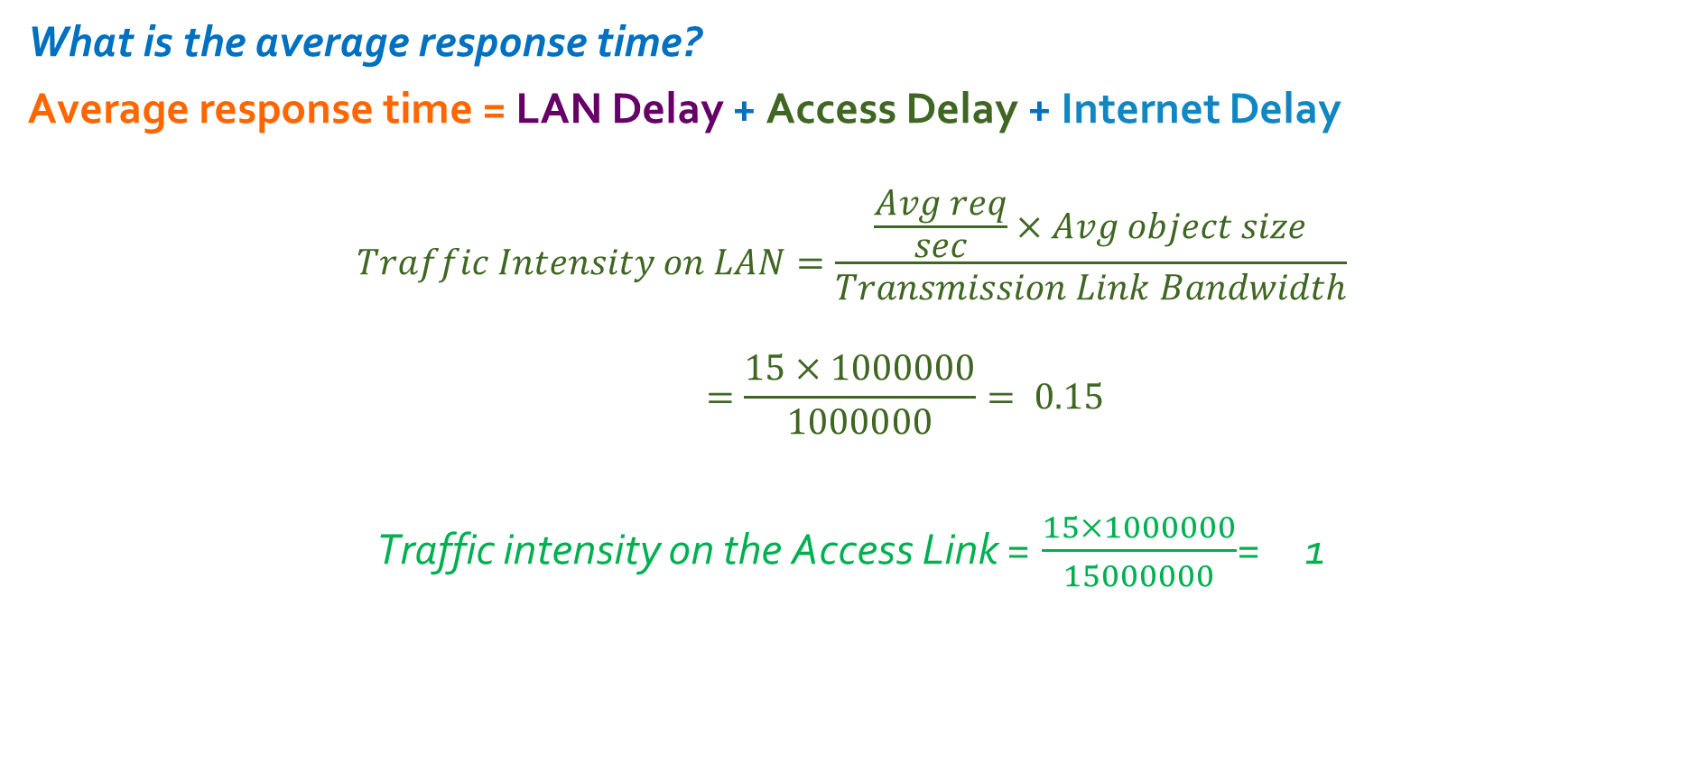
Caching example:
Assumptions:
Avg object size: 1 Mbits
Avg request rate from browsers to origin servers:15/sec
RTT from institutional router to any origin server : 2 sec
100000000

Slide 64
Caching example:
Consequences:
LAN utilization: 15%
Access link utilization = 100%
The Access Link becomes a Choke point

Slide 65
Caching example: Solution
What is the average response time?
Average response time = LAN Delay + Access Delay + Internet Delay
Delay is in tens of msecs
Delay is in of minutes.
Delay is 2 secs.
Solution of reducing delay:
Increase the bandwidth of the access link.
Install a web cache or proxy server at the institutional network.

Slide 66
Caching example: Solution 1
Assumptions:
Avg object size: 100K bits
Avg request rate from browsers to origin servers:15/sec
RTT from institutional router to any origin server: 2 sec
Access link rate: 15 Mbps
Consequences:
LAN utilization: 15%
Access link utilization = 100%
100 Mbps
Access Link
100 Mbps
15%
Average response time = LAN Delay + Access Delay + Internet Delay
= msecs + mins + 2 secs
msecs
LAN Delay and Access delay becomes negligible
Cost: increased access link speed (not cheap!)

Slide 67
Caching example: Solution 2
Assumptions:
Average hit rate: 40%
Consequences:
LAN delay = within 10 milliseconds
Access delay = tens of milliseconds in a 15 Mbps Link
Total Response time:
origin
servers
public
Internet
15 Mbps
access link
= 0.4(0.01 seconds)+0.6(0.01+ 2 seconds)
= 1.2 secs
institutional
network
100 Mbps LAN
local web
cache
Cost: web cache (cheap!)

Slide 68
Stale Cache
One problem of using Proxy server
  The object housed in the Web server may have been modified since the copy was cached at the client.
HTTP has a mechanism that allows a cache to verify that its objects are up to date.
This mechanism is called the conditional GET.
An HTTP request message is a so-called conditional GET message if
  The request message uses the GET method
  The request message includes an If-Modified-Since: header line.

Slide 69
Conditional GET
proxy server
server
Goal: Don’t send object if cache has up-to-date cached version
  No object transmission delay
  Lower link utilization
Cache: specify date of cached copy in HTTP request
  If-modified-since: <date>
Server: response contains no object if cached copy is up-to-date:
  HTTP/1.0 304 Not Modified
HTTP request msg
If-modified-since: <date>
object
not
modified
before
<date>
HTTP response
HTTP/1.0
304 Not Modified
HTTP request msg
If-modified-since: <date>
object
modified
after
<date>
HTTP response
HTTP/1.0 200 OK
<data>

Slide 70
Conditional GET
Using ETag
Sending Conditional GET
GET /logo.png HTTP/1.1
Host: example.com
If-Modified-Since: Wed, 27 Oct 2025 10:00:00 GMT
Server Reply (No change)
HTTP/1.1 304 Not Modified
Server Reply (Change)
HTTP/1.1 200 OK
Last-Modified: Wed, 28 Oct 2025 08:00:00 GMT
[new file content follows...]
GET /logo.png HTTP/1.1
Host: www.example.com
If-None-Match: "abc123"
HTTP/1.1 304 Not Modified
HTTP/1.1 200 OK
ETag: "xyz456"
[File data here...]

Slide 71
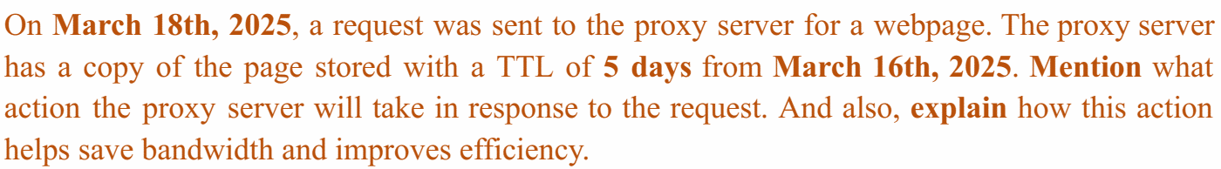
The webpage cached on: March 16
Valid until: 16+(5-1)=20 March [Fresh]
Stale on 21 March.
The client will be served from the Proxy’s cache copy
Benefits
Proxy does not need to request the same copy from the original server again
This reduces bandwidth consumption and processing speed of the proxy

Slide 72
HTTPS
Part 6

Slide 73
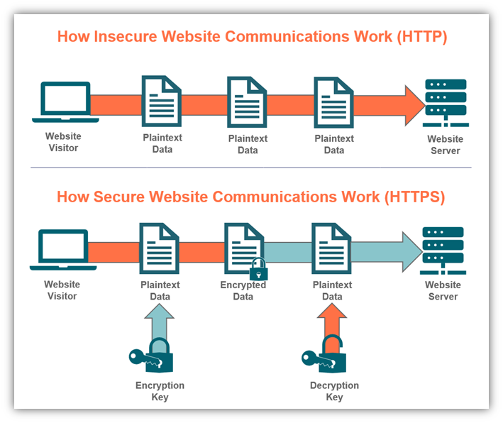
HTTPS
More secure version of HTTP
Allows transferring the data in an encrypted form.
Uses an encryption protocol known as Transport Layer Security, and officially, it is referred to as a Secure Sockets Layer (SSL).
HTTPS transmits the data over 443 port number.

Slide 74
Steps
  A browser connects to the server using HTTPS.
  The server sends its SSL certificate to the browser.
  The browser checks the certificate’s authenticity.
  If valid, both sides agree on a session key to encrypt data.
  From now on, all communication is encrypted.

Slide 75

HTTPS
Websites to have an HTTPS protocol, need to install the signed SSL certificate.
The SSL protocol encrypts the data which the client transmits to the server.
This digital certificate is a file that contains
  Information about the organization to help it authenticate
  Cryptographic information that helps site users communicate with it securely through encryption.
It is a transport layer protocol.
SEO Advantage : GOOGLE gives the preferences to those websites that use HTTPS rather than the websites that use HTTP.

Slide 76
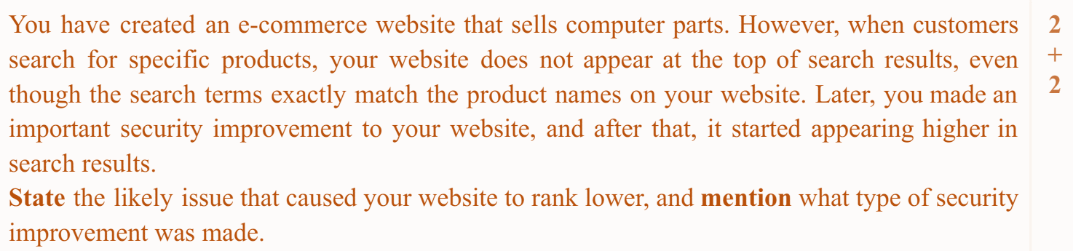
Problem: You are using HTTP
Solution: Use HTTPS

Slide 77
THE END

